Slide 1
Football Analysis
Fenil Patel

Slide 2
Problem Statement
Objective: Development of a Analysis System of Football at the International and Club Level.
Abstract of the Project: The project is to develop a detailed Analysis of Football where we analyze the raw source data available to us and after extracting and transforming the raw data into dimension and fact tables. After deriving the required tables, we make a detailed analysis of the football players and the team based on the facts.
Technology Used: GDE 3.2.5.2 Unicode(Ab Initio) as the ETL tool, Teradata was used to store the data from ETL and later it was used by the Qlikview for reporting purpose.

Slide 3
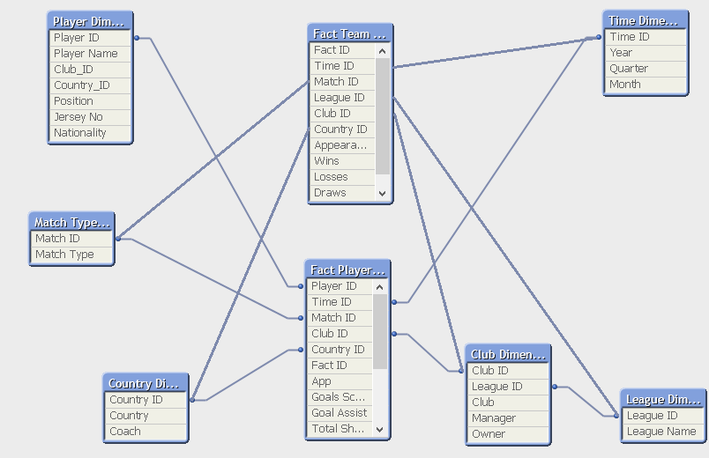
OLAP SCHEMA DIAGRAM (Fact Constellation)

Slide 4
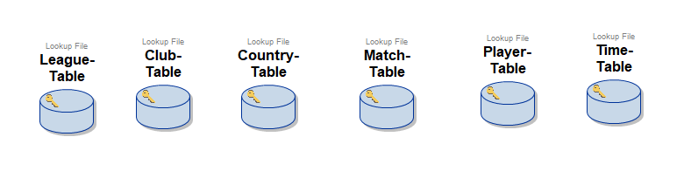
Dimension Table (Lookup)

Slide 5
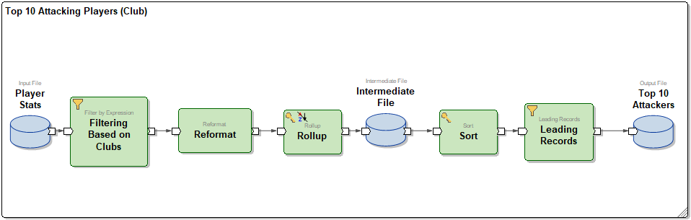
Top 10 Attacking Players(Club)
Top 10 Attacking players(Country): The best players overall for a particular club, of all time.

Slide 6
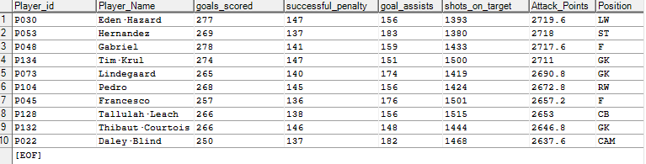
Top 10 Attacking Players(Club) Output

Slide 7
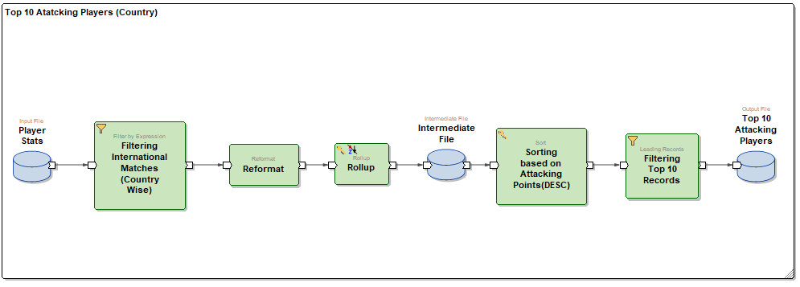
Top 10 Attacking Players(International)
Top 10 Attacking players(Club): The best players overall for a particular country, of all time.

Slide 8
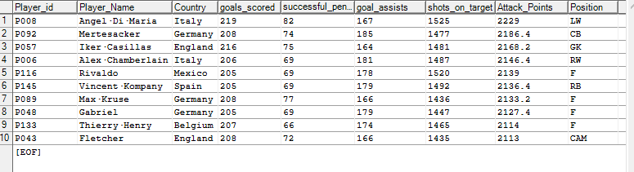
Top 10 Attacking Players(International) Output:

Slide 9
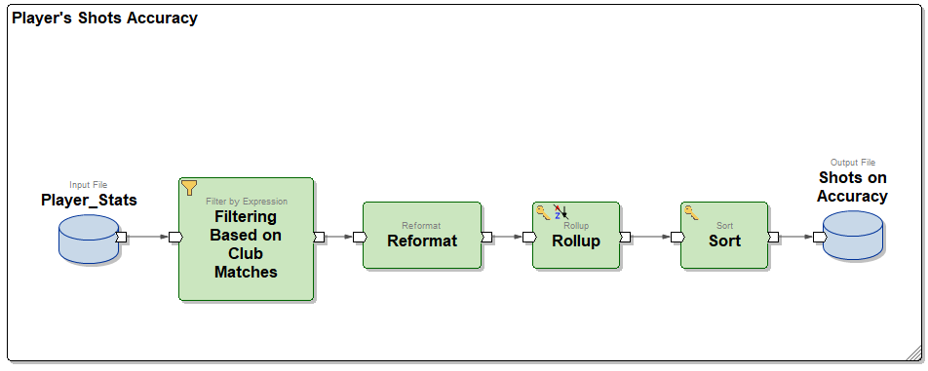
Player’s Shot Accuracy(Club)
Player’s Shot Accuracy(Club): The ratio of shots on target to total shots.

Slide 10
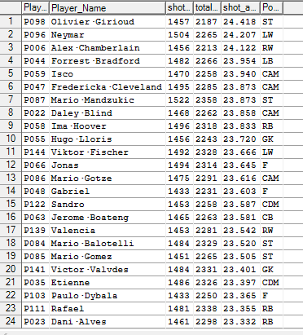
Player’s Shot Accuracy(Club) Output:

Slide 11
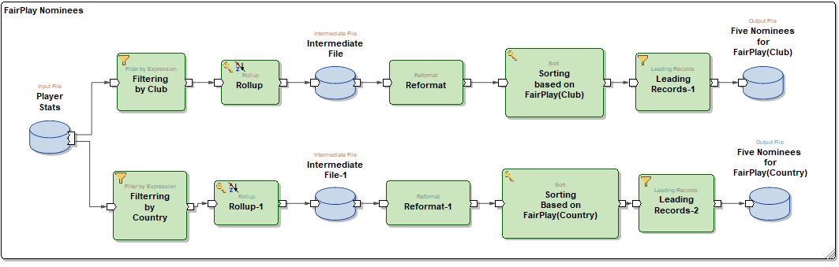
Nominees For Fair Play
Nominees for Fair play: The players who have made the least amount of fouls.

Slide 12
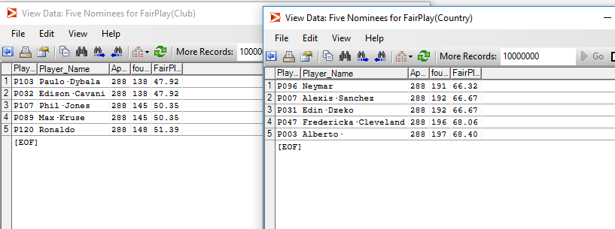
Nominees For Fair Play Output:

Slide 13
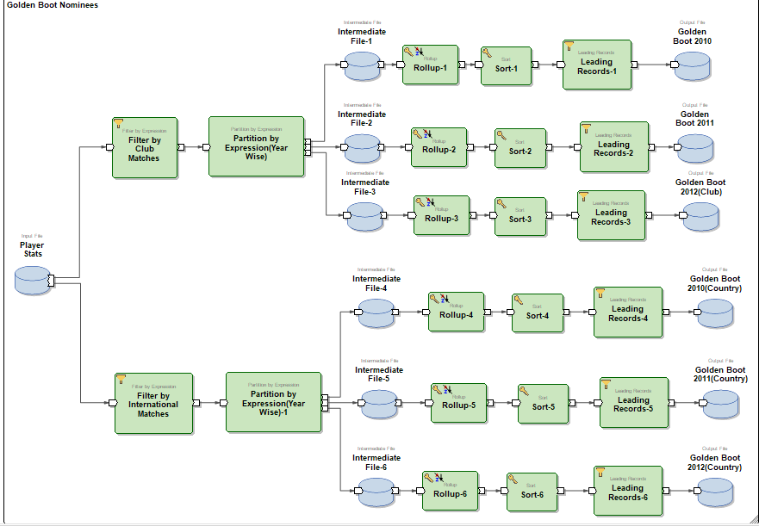
Nominees For Golden Boot
Top 10 Attacking players(Club): The best players overall for a particular club of all time.

Slide 14
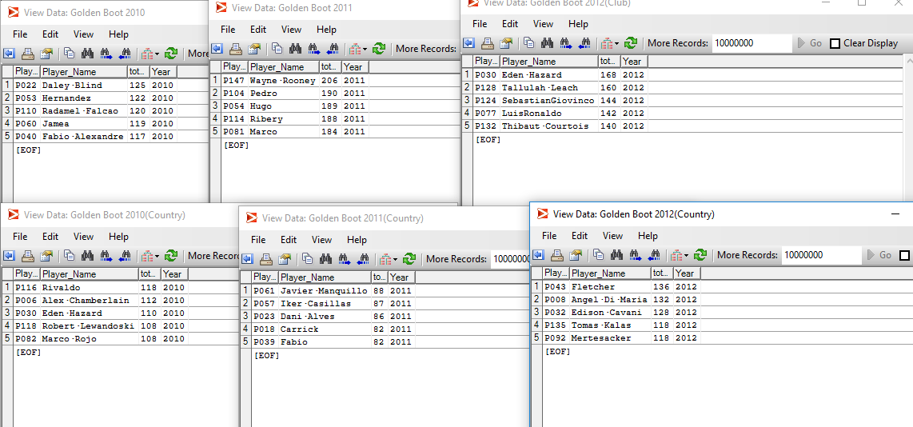
Nominees For Golden Boot Output:

Slide 15
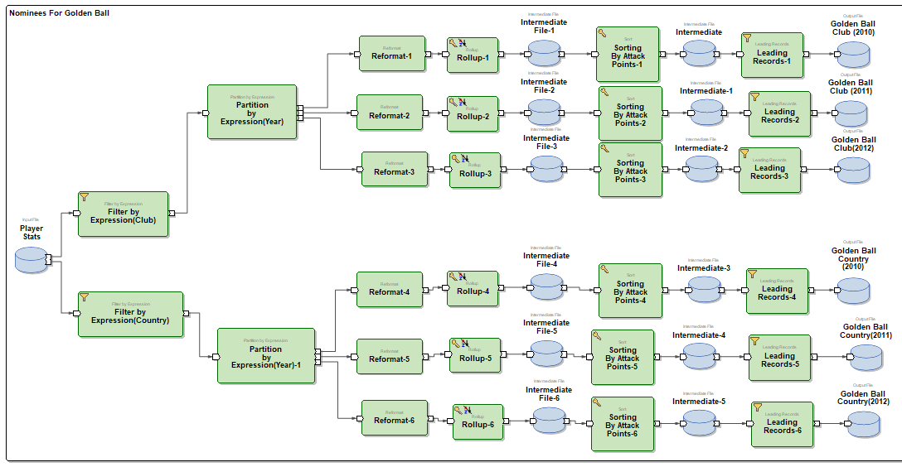
Nominees For Golden Ball
Nominees for Golden Ball: The highest goal-scorer overall for a particular year(awarded every year).

Slide 16
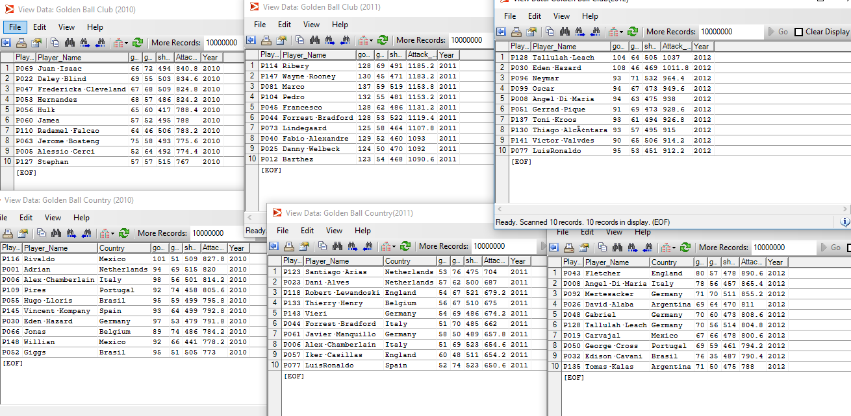
Nominees For Golden Ball Output:

Slide 17
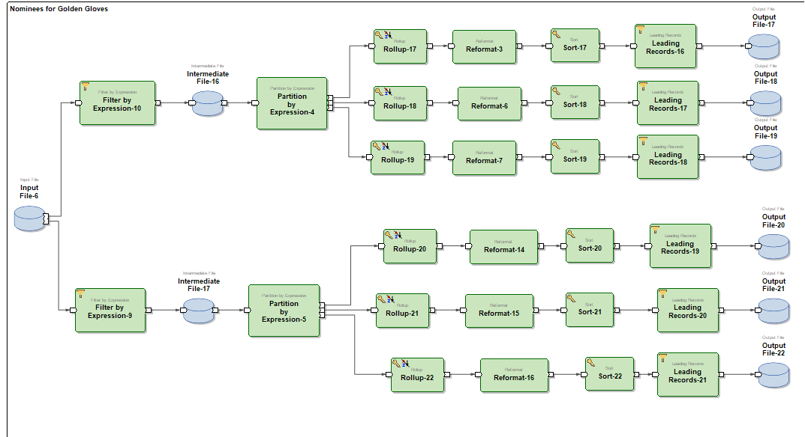
Nominees for Golden Gloves
Nominees for Golden Gloves: The best goalkeeper, who stopped the most number of goals, for a particular club of all time.

Slide 18
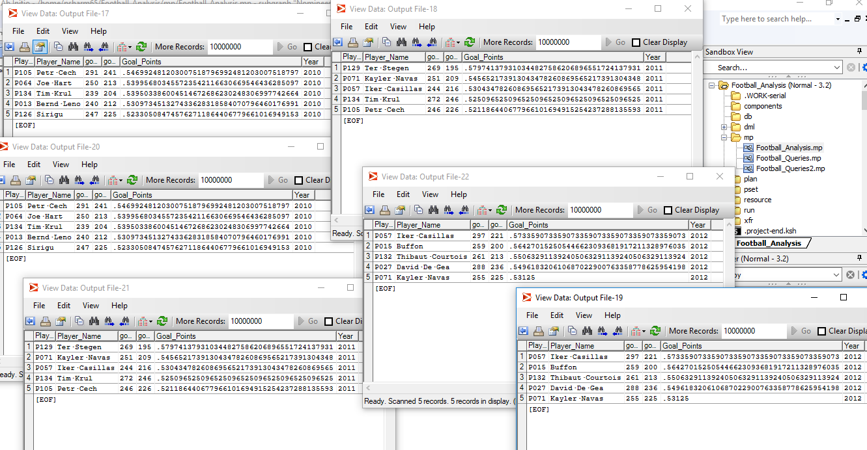
Nominees for Golden Gloves Output:

Slide 19
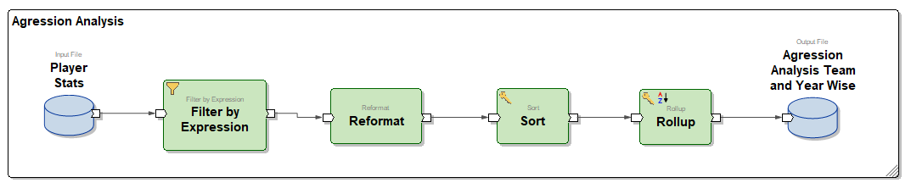
Yearly Aggression Analysis for Each Player(Club)
Yearly Agression: The players who have fouled most number of times, sorted yearly as well as club wise.

Slide 20
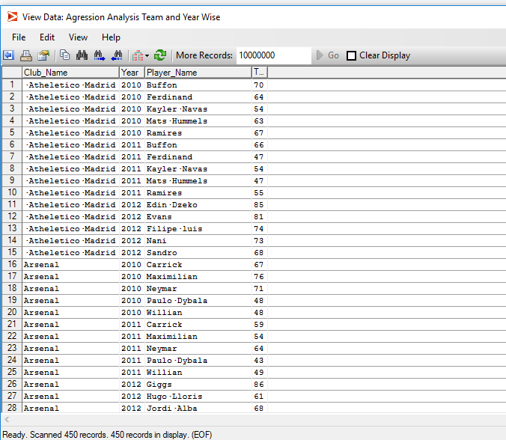
Yearly Aggression Analysis for Each Player(Club) Output:

Slide 21
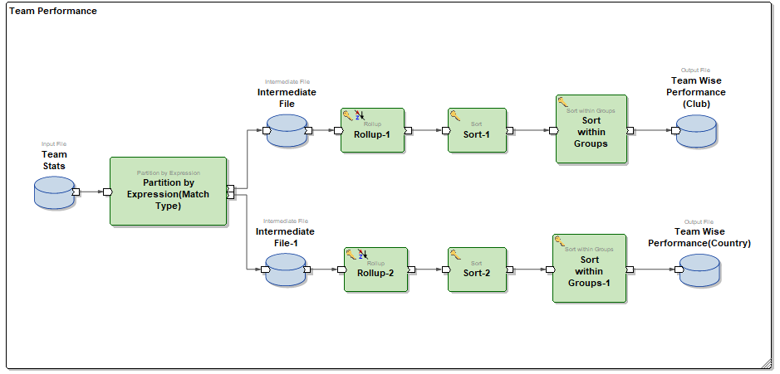
Club Analysis and Country Analysis
Club and Country Analysis: The overall performance of teams.

Slide 22
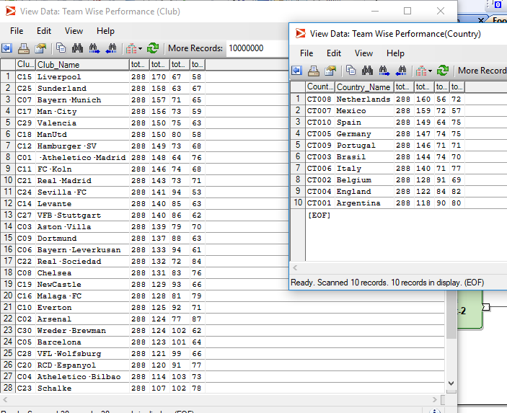
Club Analysis and Country Analysis Output:

Slide 23
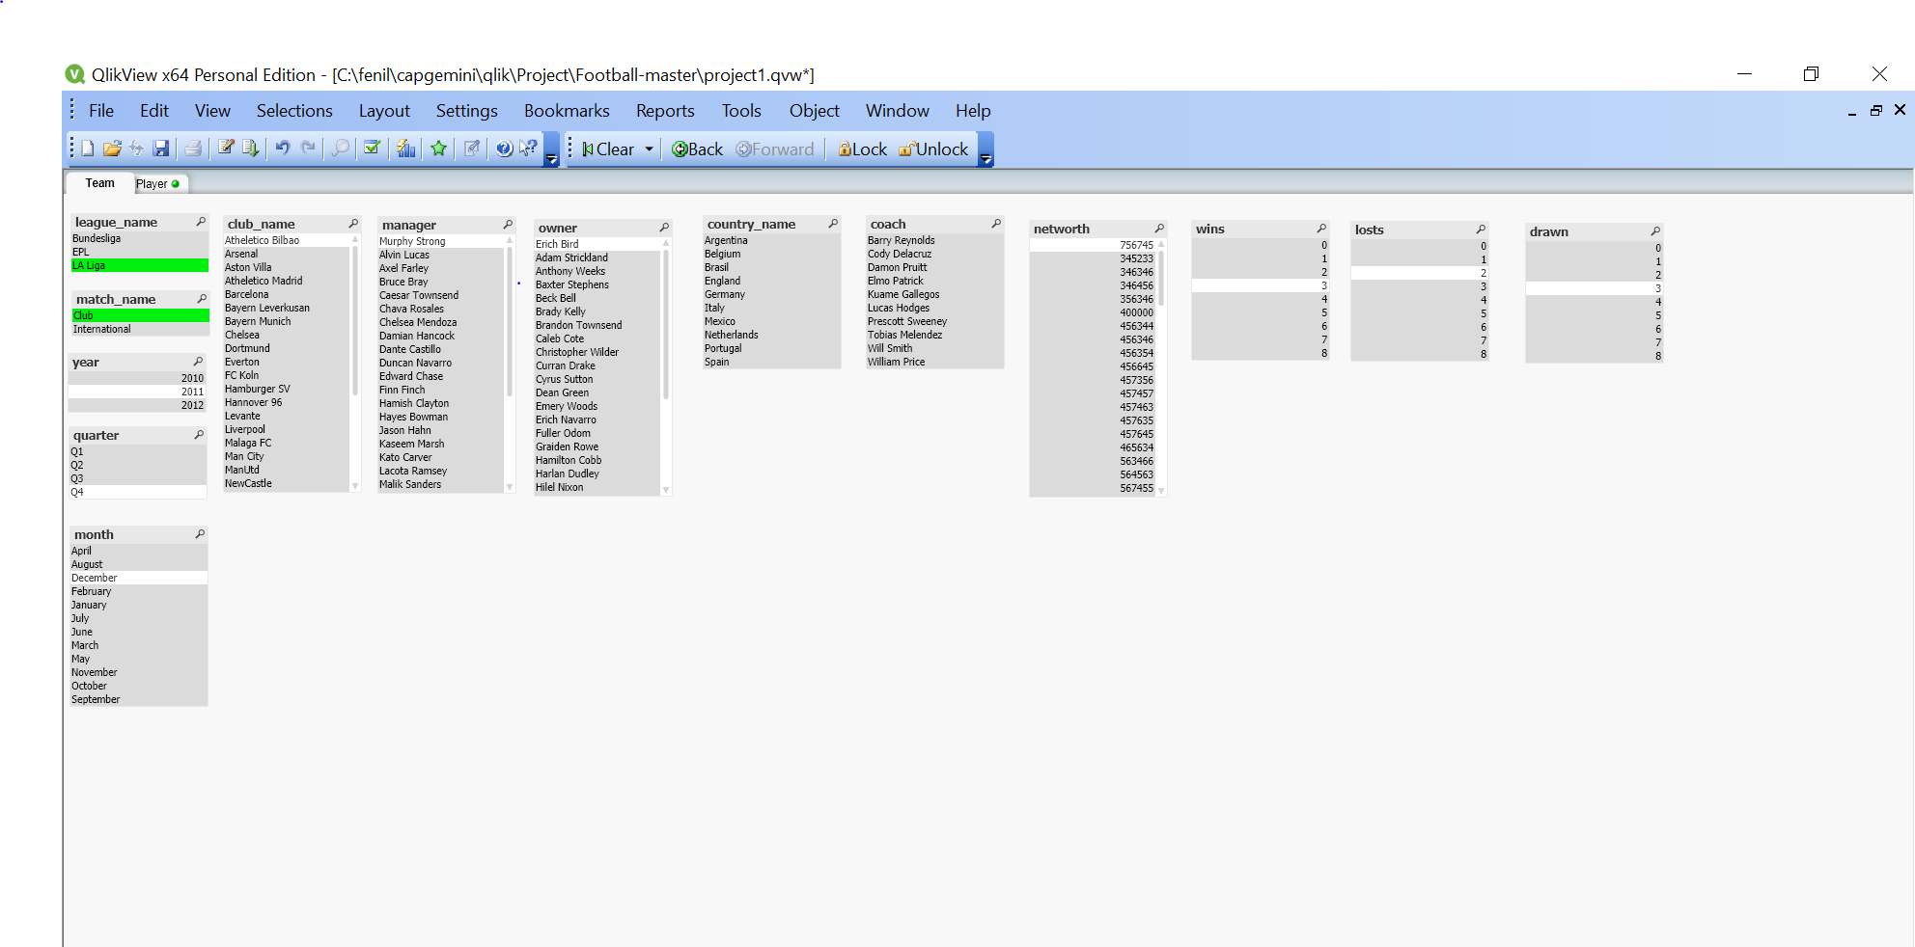
Reporting Tool Analysis based on Team

Slide 24
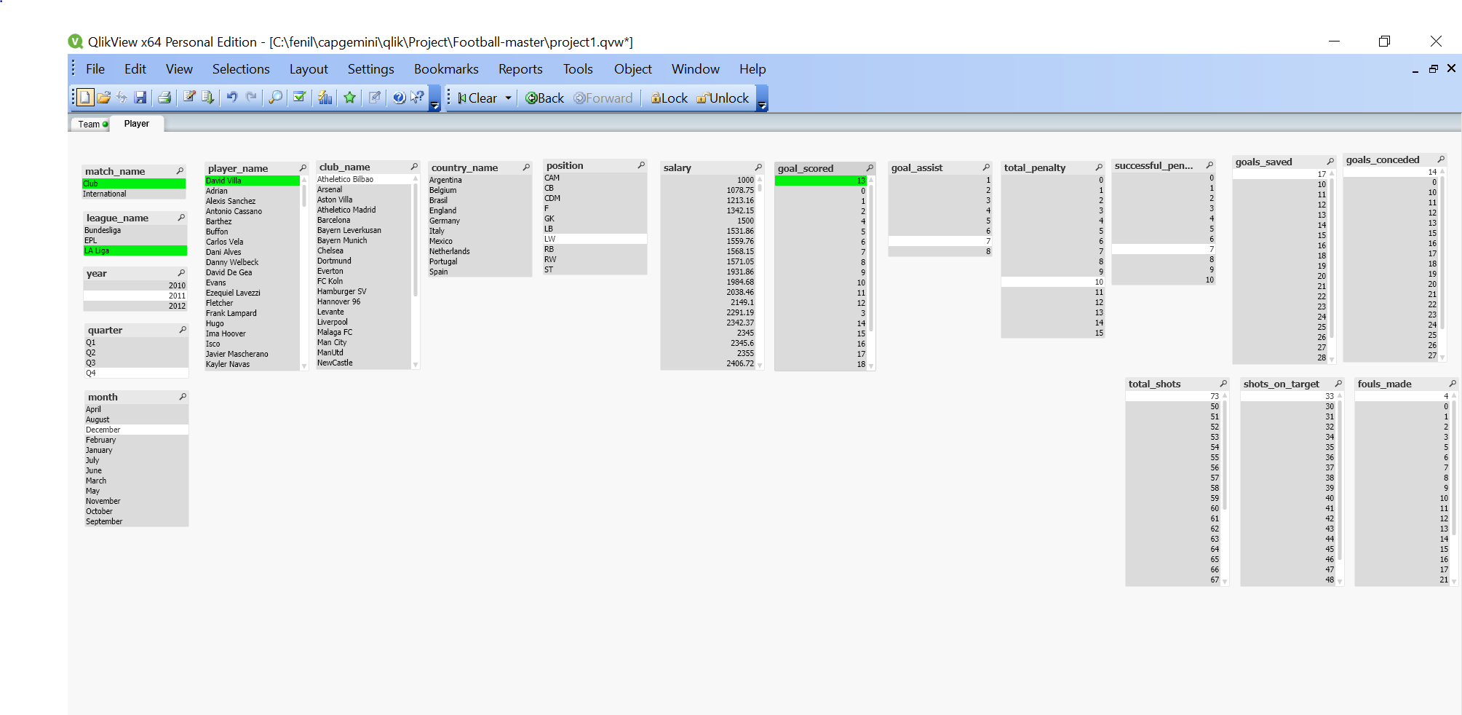
Reporting Tool Analysis based on Player

Slide 25
Conclusion
The Analysis System of Football was prepared. The optimum coding standards were maintained, efforts were made to make the system error free. All the relevant procedure were followed to make the system efficient for the purpose it was prepared for.

Slide 26
Thank You

